Slide 1



Exploring Cybersecurity Threats in Digital Marketing

Slide 2
Abstract
The primary objective of any form of online marketing business is to connect a business or organization with its target audience via digital channels in order to increase its reach. Cybersecurity is crucial to digital marketing hence dealing with security threats in cyberspace is essential for success in digital marketing. Promotions have to be done using an efficient marketing strategy that doesn’t have any security issues.

Slide 3
SURVEY
In this study, a survey method is used to collect data by means of questionnaire instrument (Google forms). Usable data was collected from 680 participants who are members of a Facebook group in Nigeria, comprising 34,000 digital marketers, and the sample population was randomly selected. The questionnaire gathered data from those involved in various forms of digital marketing. The questionnaire collected data that covered: channels used by digital marketer; which of the tools/channels are more preferred by various digital marketers. The survey information collected was examined using the Statistical Package for Social Sciences (SPSS)

Slide 4


Slide 5
INTRODUCTION
Digital marketers work with e-commerce websites daily and these e-commerce websites' transactions are constantly under attack by hackers. Most times, third party services are used such as pay TM, phone Pay who use customers payment data, sometimes this customers payment information could be compromised and exploited by hackers if not handled securely. Digital marketing strategies have to be prioritized because it enables individuals or organizations to reach clients by combining advanced technologies with existing marketing plans.

Slide 6
Forms of Cyberattacks That Involves Digital Marketing:
Malware infection from files downloaded or links clicked
Browser hijacking and redirection
Stealing of data and other sensitive information
Identity theft
Proliferation of fake news
DDOS attacks on website

Slide 7
Research question formulation
What are the basic tools?
What are the digital marketing strategies?
How effective are the digital marketing tools?
What measures are taken to ensure security in cyberspace?

Slide 8
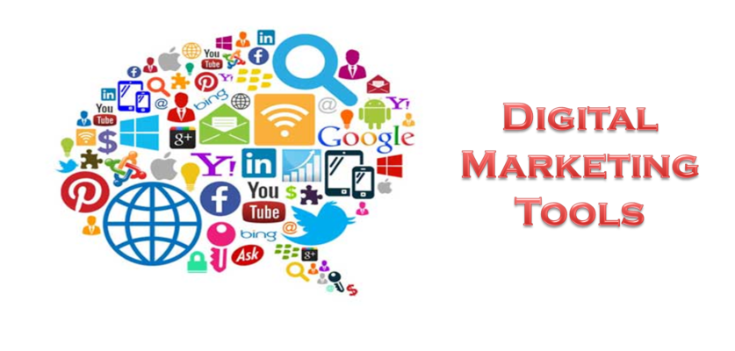

Slide 9
Most preferred tools
Technique | Tools
Paid Channel Advertising | Adword Blogs Social Media
Social Media | Facebook Instagram Twitter
Design | Canva Photoshop Animator
Video Hosting Sites | YouTube Vimeo MySpace
Analytics | Google Analytics
Search Engine Optimization (SEO) | Google Search Console Google Keyword Planner SEMRush

Slide 10
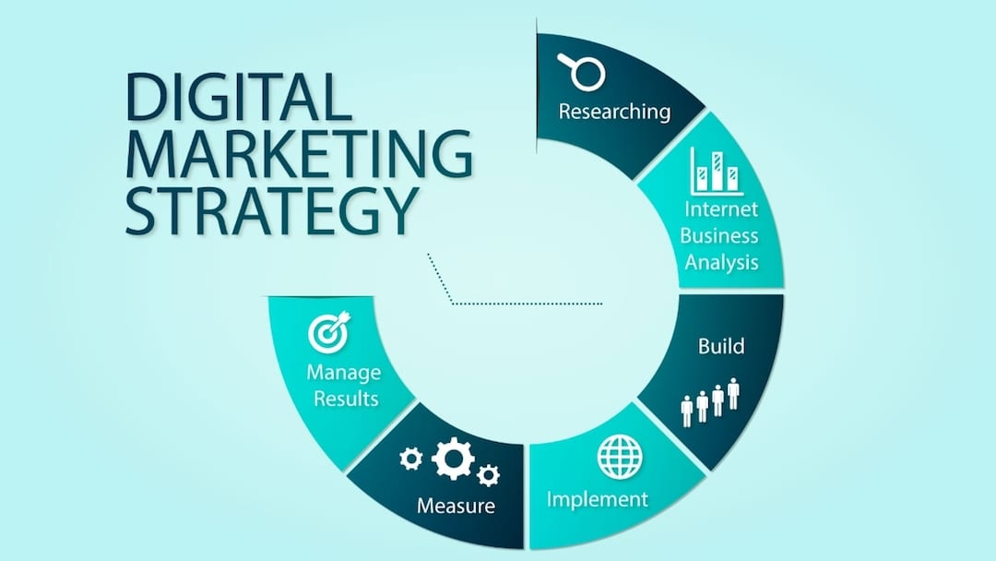

Slide 11
Digital Marketing Strategies
S/N | Types of Digital Marketing | Number of Respondent that prefer this type of Digital Marketing | %
1 | Search Engine Optimization (SEO) | 407 | 59.9
2 | Search Engine Marketing and Paid Channel Advertising | 375 | 59.9
3 | Social Network Marketing | 581 | 85.4
4 | Content marketing | 450 | 66.2
5 | Influencer Marketing | 553 | 81.3
6 | Email Marketing | 598 | 87.9
7 | Mobile Phone Marketing | 220 | 32.4

Slide 12
Challenges faced by digital marketer and solutions implemented
1. Generating traffic and leads
Creating good content
Content promotion
Linking back to website
Search engine optimization
2. Engaging social media followers
Be social
Posting interesting and useful content
Start engaging followers
Ensure every post offers real value

Slide 13
3. Search Engine Optimization (SEO) for website
Run a quick SEO audit
Hire an SEO expert
4. Managing website
Hire a freelancer
Host your website on a platform that integrates all your marketing channel

Slide 14
Cyber security threat and digital marketer handling of threats and attacks
Content Marketing
Ensure that only patched and updated operating systems and software packages are used on servers.
Content Management Systems are accessible via secure private networks alone.
User password authentication policy is enforced.
Administrators must moderate the creation of user accounts
Users must be properly trained on the security features of organization’s CMS and install updates immediately they are available

Slide 15
Email Marketing
Never open emails from unknown senders and always verify the identity of suspect email senders and their safety, by contact them before opening it.
Verify that ISP and servers are reliable and responsible.
Use security software tools to monitor your email marketing needs and ensure the emails you send out to desired audiences are encrypted to reduce the risk of a phishing attack.
Set up outbound filters to prevent emails with hidden malware.
Include the email systems in network security audit

Slide 16
E-commerce:
Use of SSL (Secure Sockets Layer) protocols and a two-step verification process
Take all the precautions to provide a safe and secure payment method for the customers.
Guaranty that hackers cannot subtly access client’s bank and card details.
Non-Human Traffic:
Botnet discovery tools search the computers against a list of threats and monitor communications for behavior patterns that can be used by bots.
CAPTCHA (Completely Automated Public Turing test to tell Computers and Humans Apart) checks that ensure that the user is human can be used to combat Bots

Slide 17
CONCLUSION
For any product or service marketing is extremely essential. People hardly find time to look around them for advertisements. So digitalization of marketing strategies has become crucial and it also has it own issues with security. Data protection is very important when its digitalized so by adopting proper cybersecurity practices and implementing network compliances in place we can make internet a safer place

Slide 18
FUTURE SCOPE
This research paper published by Susan Konyeha describes about cyber threats that are posed to digital marketing. Even though we ensure proper implementation of safe and recommended practices, new vulnerabilities and security breaches are always encountered. So we need to always update ourselves regarding the ongoing attacks and try to secure and reconsider our marketing strategy and also marketing medium . Hackers are increasing in number and always pose a threat when it comes to digital marketing this discussion can be extended to designing action plan when a cyber incident occurs and design methods to retrieve the data masqueraded while marketing

Slide 19
REFERENCES
[1] Gaikwad, M. and Kate, P.H. (2016). E-marketing: A modern approach of business at the door of consumer clear. International Journal of Research in Commerce & Management, 7(9), 56-61.
[2] Zimmer, S. (2017). Marketing. Marketing -- Research Starters Business, 1-4.
[3] Roberts, S. D., and Micken, K. S. (2015). Marketing digital offerings is different: Strategies for teaching about digital offerings in the marketing classroom. Journal of Education for Business, 90(2), 96-102.
[4] Piñeiro-Otero, Teresa and Martínez-Rolán, Xabier. (2016). Understanding digital marketing—basics and actions. Springer International Publishing Switzerland 2016, DOI 10.1007/978-3-319-28281-7_2
[5] Armitage, J. (2015). Strategic insights. Marketing Insights, American Marketing Association, ISSN: 1040- 8460. 27(1), 22-23
[1] Gaikwad, M. and Kate, P.H. (2016). E-marketing: A modern approach of business at the door of consumer clear. International Journal of Research in Commerce & Management, 7(9), 56-61. [2] Zimmer, S. (2017). Marketing. Marketing -- Research Starters Business,

Slide 20
THANKYOU
SVN. Ramakanth
1602-19-733-118

